Slide 1

Project team Orange
EDA Phase Presentation
Team Members:
Ibrahim Mohammed Hamed
Ruta Patel
Sneha
Prachi Singh
Vishnushashank Shesam
Faizalabbas Saiyed

Slide 2
Problem Statement
Why are some customers leaving the Great One Bank Inc. credit card services?

Slide 3
Exploratory Data Analysis Goal
To provide an initial set of independent variables and possible three machine learning models after thorough analysis.

Slide 4
Independent variables chosen for analysis by Ibrahim
Total Trans Amount
Months Inactive 12 Mon

Slide 5
Individual analysis of my two independent variables
What Kind of two independent variables?
Total Trans Amount: Numeric
Months Inactive 12 Mon: Numeric

Slide 6
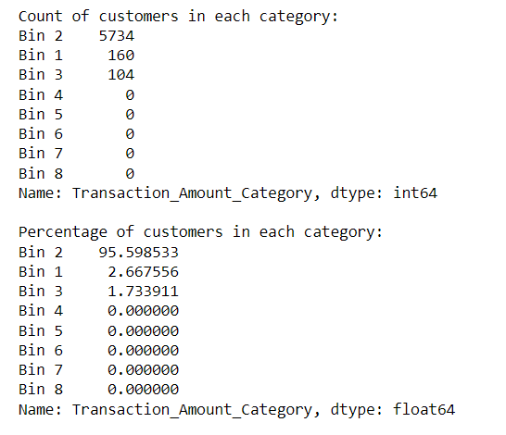
What proportion of the values are they?
Total Trans Amount:
The majority of customers fall into Bin 2, representing approximately 95.6% of the total.
Bins 1 and 3 have smaller percentages of around 2.7% and 1.7%, respectively.
Bin 2 could be considered as a category with a medium transaction amount, given its high proportion.
Bins 1 and 3 might represent low and high transaction amounts, respectively.

Slide 7
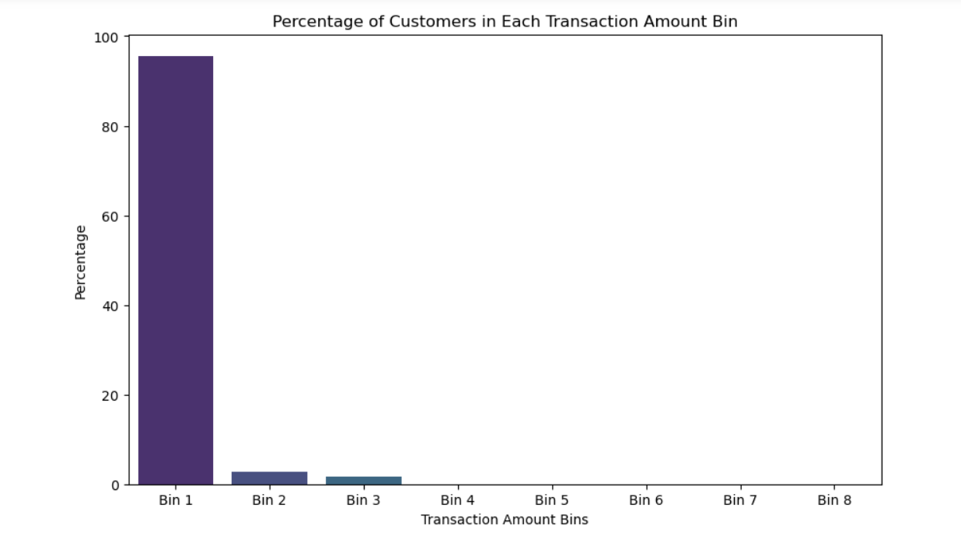
Bins 4 to 8 have zero counts, suggesting that there might be gaps or extreme values in the data. Therefore it is not considered.
Understanding the distribution across bins is crucial for modeling, as it helps identify patterns and trends in customer behavior.
These bins can potentially serve as features in predictive models, capturing the variability in transaction amounts.

Slide 8
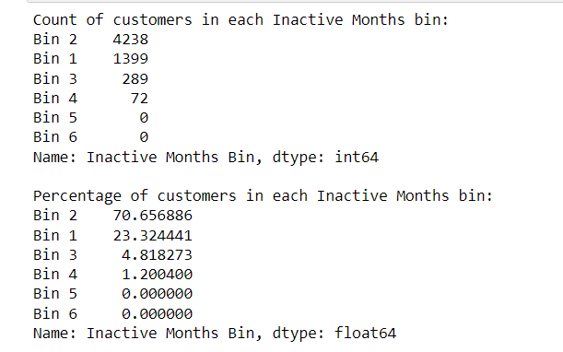
Months Inactive 12 Mon:
The majority of customers fall into 'Bin 2' (70.66%), indicating that a significant portion of customers has been moderately inactive (between 2 to 4 months) in the last 12 months.
'Bin 1' (23.32%) represents customers with low inactivity (0 to 2 months), suggesting a sizable proportion of customers who have been consistently active.

Slide 9
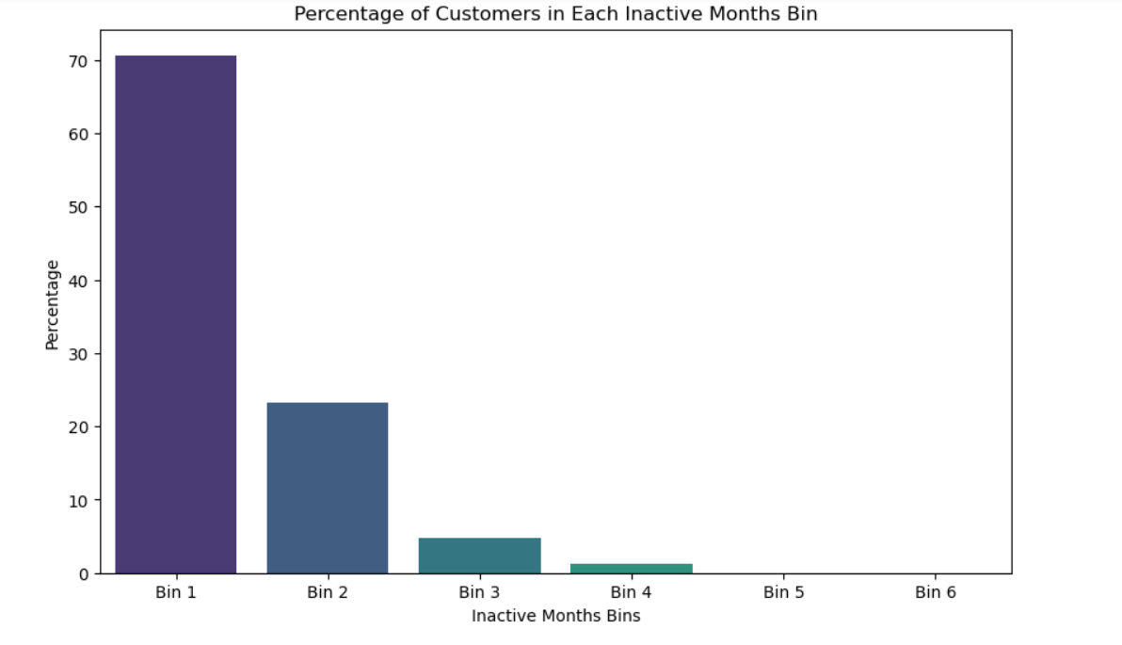
There are smaller percentages of customers in 'Bin 3' (4.82%) and 'Bin 4' (1.20%), which indicate customers with higher levels of inactivity (4 to 6 months).
No customers fall into 'Bin 5' and 'Bin 6,' suggesting that there are no instances of extremely high inactivity (more than 6 months).
When building predictive models, the 'Months Inactive 12 mon' variable can be a valuable predictor, especially considering the varying levels of customer inactivity.

Slide 10
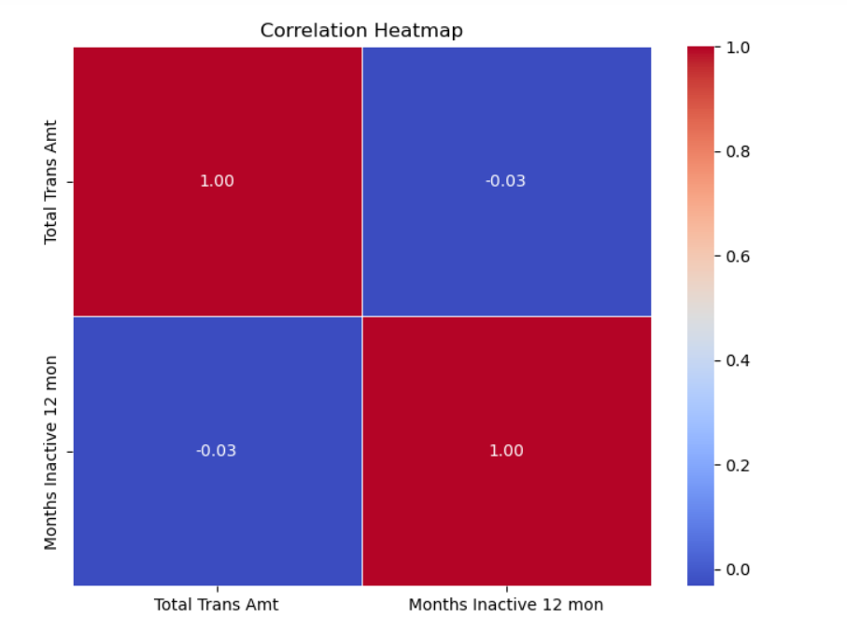
Are these independent variables are correlated to other independent variables, or not?
The correlation coefficient is close to zero for both variables, indicating a weak correlation. It means that changes in one variable are not strongly associated with changes in the other.
Hence, these two variables do not exhibit a strong linear relationship. This information is crucial for feature selection when building predictive models.
As the correlation coefficient is close to zero, there is no clear linear trend between the total transaction amount and the number of inactive months.

Slide 11
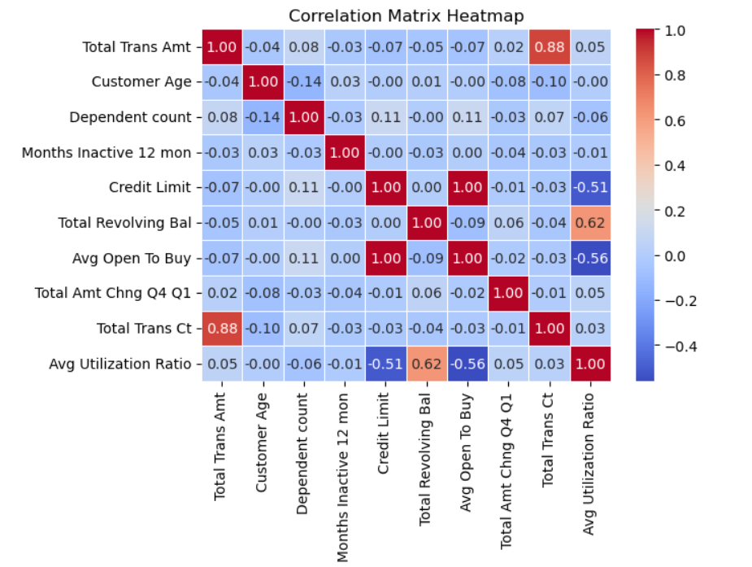
Correlation for Total Trans Amt with other independent variables
Total Trans Amt and Total Trans Ct (Total Transaction Count):
There is a strong positive correlation of 0.88 between Total Trans Amt and Total Trans Ct.
This indicates that as the total transaction amount increases, the total transaction count also tends to increase.
Credit Limit and Avg Open To Buy:
There is a strong negative correlation of -0.56 between Credit Limit and Avg Open To Buy.
This suggests an inverse relationship, meaning as the credit limit increases, the available credit for buying (Avg Open To Buy) decreases.
Total Revolving Bal and Avg Utilization Ratio:
There is a strong positive correlation of 0.62 between Total Revolving Bal and Avg Utilization Ratio.
This implies that customers who have a higher total revolving balance tend to have a higher average utilization ratio.

Slide 12
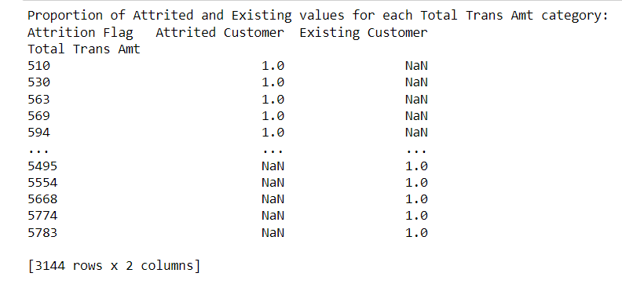
The proportion of Attrited or Existing values in the target associated with each value of the independent variable:
Total Trans Amount:
For certain Total Transaction Amounts (e.g., 510, 530, 563, 569, 594), all customers who experienced attrition had a value of 1.0, meaning 100% attrition in those specific categories.
for some Total Transaction Amounts (e.g., 5495, 5554, 5668, 5774, 5783), there is no attrition (Attrited Customer values are NaN), indicating that customers with those transaction amounts did not experience attrition
NaN values are unexpected. The absence of attrition values in certain categories is due to a genuine lack of attrition.

Slide 13
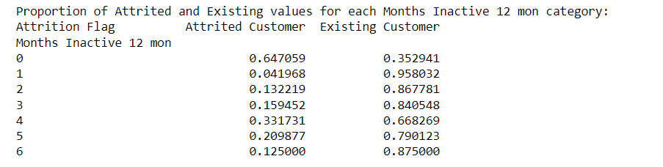
Months Inactive 12 Mon:
The proportions of Attrited and Existing customers vary across different inactivity periods (Months Inactive 12 mon).
For instance, inactivity periods of 0, 1, and 2 months have relatively higher proportions of existing customers, while periods of 4 and 5 months have higher proportions of attrited customers.
There is a noticeable increase in the proportion of attrited customers as the inactivity period extends (e.g., from 0.33 at 4 months to 0.647 at 6 months).
Longer periods of inactivity seem to correlate with a higher likelihood of attrition.
Customers with shorter inactivity periods may require different retention strategies compared to those with longer periods.
Using these insights we can focus on engagement efforts for customers in specific inactivity periods.

Slide 14

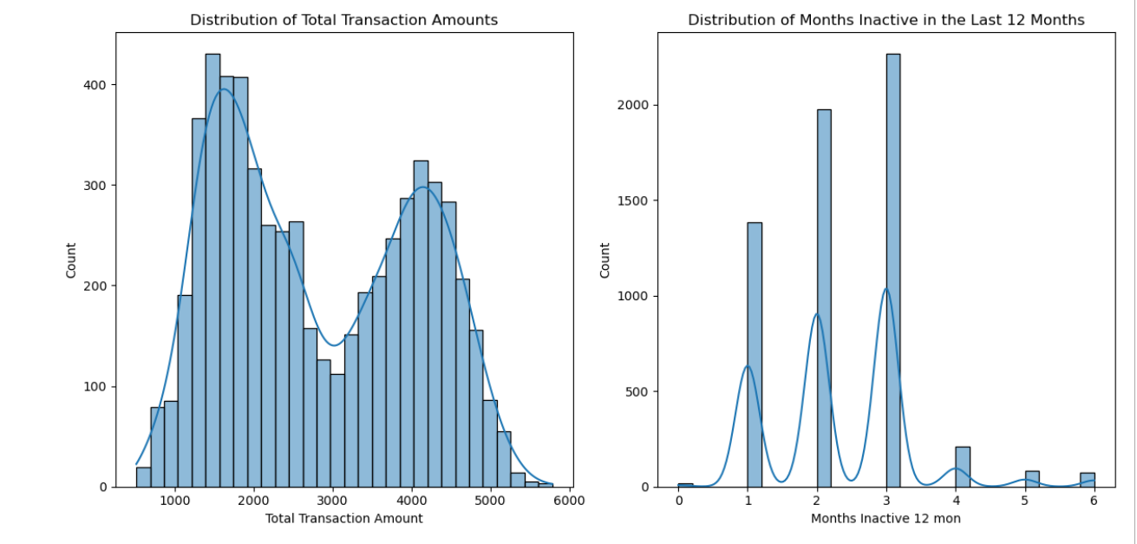
Hypothesis testing of the two independent variables as predictor candidates:
For 'Total Trans Amt':
H0: The mean of 'Total Trans Amt' for attrited customers is less than or equal to the mean for existing customers.
Ha: The mean of 'Total Trans Amt' for attrited customers is greater than the mean for existing customers.
The curves in the plots suggest that the data may not be perfectly normal. However, the t-test is robust and can still provide meaningful results with larger sample sizes, even if the data deviates slightly from normality.

Slide 15

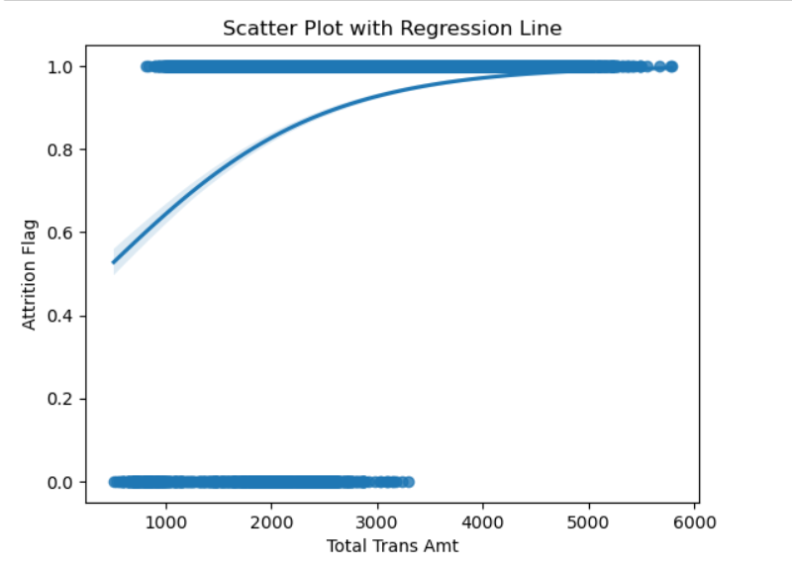
Relationship of Total Trans Amt with Attrition flag
To interpret this: The point-biserial correlation coefficient is approximately 0.30, indicating a moderate positive correlation between "Total Trans Amt" and the likelihood of attrition. The positive sign suggests that as the total transaction amount increases, the probability of attrition also tends to increase.
The extremely small p-value (close to zero) indicates that this correlation is statistically significant. Therefore, we can reject the null hypothesis, suggesting that there is a significant relationship between "Total Trans Amt" and "Attrition Flag."

Slide 16
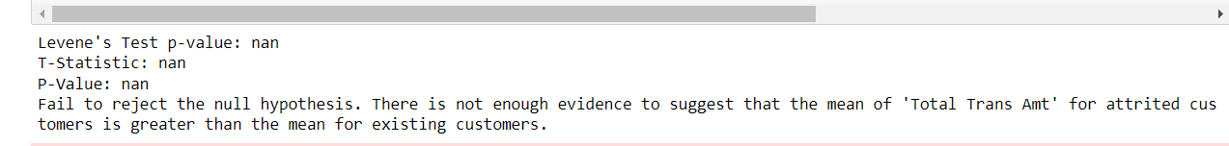
Given that the Levene's test for equality of variances resulted in NaN and the t-test statistics and p-values are also NaN, it indicates that there might be an issue with the data or the conditions for the t-test are not met.

Slide 17
Hypothesis testing of the two independent variables as predictor candidates:
For 'Months Inactive 12 mon':
H0: The mean of 'Months Inactive 12 mon' for attrited customers is less than or equal to the mean for existing customers.
Ha: The mean of 'Months Inactive 12 mon' for attrited customers is greater than the mean for existing customers.

Slide 18
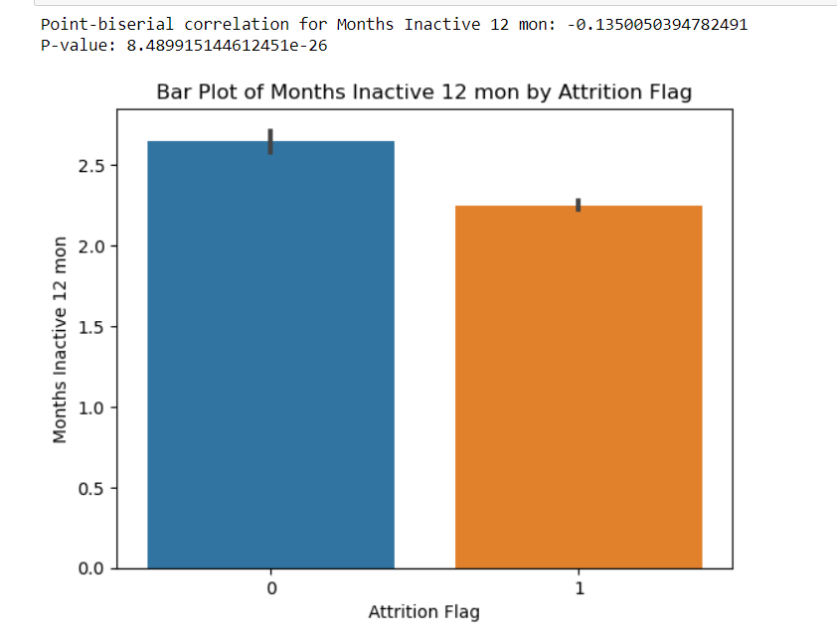
Relationship of Months inactive 12 mon with Attrition flag
The point-biserial correlation for 'Months Inactive 12 mon' and 'Attrition Flag' is approximately -0.135, and the p-value is very small (close to zero), indicating that there is a statistically significant negative correlation between the number of months inactive and the likelihood of attrition.
A negative correlation suggests that as the number of months inactive increases, the likelihood of attrition decreases.
The small p-value suggests that this correlation is unlikely to be due to random chance.
The p-value, which is very close to zero, provides strong evidence against the null hypothesis of no correlation. Therefore, we reject the null hypothesis and conclude that there is a significant negative correlation between the number of months inactive and the likelihood of attrition.

Slide 19
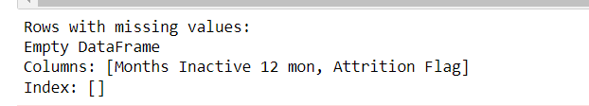
There are no missing values in the selected columns, which means that the analysis includes complete data for the variables of interest ('Months Inactive 12 mon' and 'Attrition Flag'). This enhances the reliability of the statistical tests conducted on these variables.

Slide 20
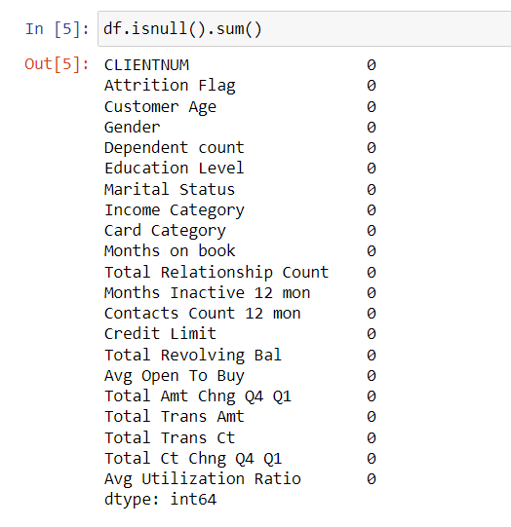
Should this variable should be included, or not included, in the models for the following reason(s):
Total Trans Amt:
T-Statistic: nan
P-Value: nan
The t-test for 'Total Trans Amt' resulted in
nan values for both the t-statistic and p-value, despite
There were no missing values.
This may be due to lack of variability in the data for this variable.
As a result, it might not provide meaningful information and could be considered for exclusion.
The chi-square test is more suitable for categorical variables, and 'Total Trans Amt' is a continuous variable.

Slide 21
Should this variable should be included, or not included, in the models for the following reason(s):
Months Inactive 12 mon:
T-Statistic (Months Inactive 12 mon): nan
P-Value (Months Inactive 12 mon): nan
Similar to 'Total Trans Amt', the t-test for 'Months Inactive 12 mon' also
resulted in nan values for both the t-statistic and p-value,
despite there were no missing values. This suggests a lack of variability or constant values.
Therefore, this variable might not contribute meaningful information and could be considered for exclusion.

Slide 22
Summary:
In summary, based on the t-test results, both 'Total Trans Amt' and 'Months Inactive 12 mon' may not be suitable as predictor
Variables for customer attrition due to issues with variability or constant values.
Considering these findings, it's advisable to explore alternative variables or conduct further investigation to identify more informative predictors.

Slide 23
Group summary and conclusions
We recommend that the initial model(s) to be trained are :
Logistic Regression
Random Forest
Linear Regression
Based on these EDA findings
We can say that variables that can be included are Income category, Average utilization ratio, Total revolving balance, Total count change Q4 Q1, Customer Age
However, the final decision should be based on further model evaluation metrics like accuracy, AUC-ROC curve when training predictive models.

